Slide 1
MWFA Temporary Dismissal
2019 Procedure
Frank Maiuolo
MWFRA - Branch Coach
For use by MWFRA only.

Slide 2
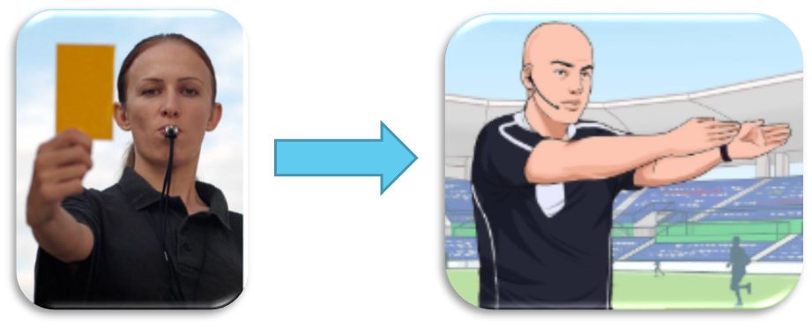
Temporary Dismissal
Procedure
A temporary dismissal (TD) incurs a caution – yellow card (YC) for the offence of ‘dissent’ by word or action, applicable to on-field players only (including goalkeepers).
The referee shows the offending player a YC for ‘dissent’ by word or action towards any Match Official and points with both arms to the technical area.
For use by MWFRA only.

Slide 3
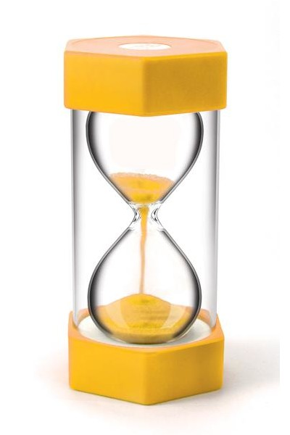
Temporary Dismissal
Duration
TD period is 5 minutes for games of 60 minutes and less (U12-U14)
TD period is 10 minutes for games over 60 minutes (U15 and up)
For use by MWFRA only.

Slide 4
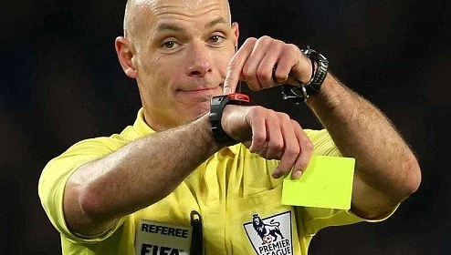
Temporary Dismissal
Time keeping
Start of TD period
After the player has left the field of play, the temporary dismissal period begins from when play is restarted. The referee will manage the timing of the dismissal period by recording the commencement time of the TD and take note of the expected completion time. This responsibility may be delegated to one of The Other Match Officials.
Completion of TD period
Once the TD period has been completed, the same player may return from the halfway line, only after receiving the referee’s permission, which may be given whilst the ball is in play. The Referee must wait for an appropriate time to call the player back on (similar to an injured player returning to the field). This may result in the dismissal period being slightly extended.
For use by MWFRA only.

Slide 5

Temporary Dismissal
Substitution/interchange
A TD player cannot be substituted/interchanged until the end of the TD period, provided play has been stopped and the team has not used all its permitted substitutes
Where a player has already received a caution (YC) for any offence in a match and then commits dissent (YC), the TD cannot be used, as this player will be sent-off/Red Card for receiving a second caution in the same match and may not be replaced or substituted/interchanged
A player serving a TD may be cautioned (YC) a second time whilst on the sideline for dissent, thus sent-off/Red Card after showing a second caution (YC). A TD player will be subject to a second caution (YC) if entering the field without the referee’s permission, equating to a send-off/Red Card.
For use by MWFRA only.

Slide 6
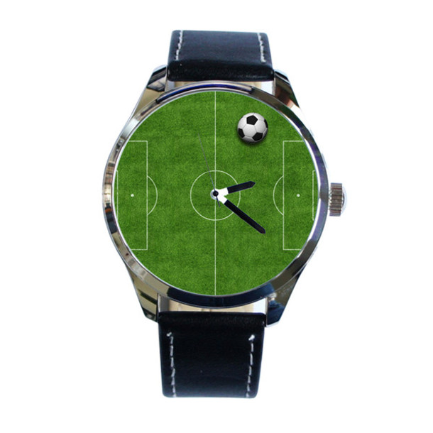
Temporary Dismissal
Play is stopped
TD at the conclusion of a half
If a TD period has not been completed at the end of the first half (or second half when extra time is to be played) the remaining part of the TD period is served from the start of the second half (or start of extra time). The player is permitted to take part in Kicks from the Penalty Mark (penalty shoot-out). Stoppage time added to the end of a half counts towards the temporary dismissal period, applicable only to 90-minute games.
Play is stopped to caution without a foul
If play is stopped to caution (YC) and TD a player, play is restarted by an indirect free kick to the opposing team from the place the ball was positioned when play was stopped. If the ball is out of play, play is restarted according to the previous decision (i.e. throw in, corner kick, free kick etc…)
For use by MWFRA only.

Slide 7

Additional Clarification
A TD player is permitted to ‘warm-up’ under the same conditions as a substitute (i.e. must be wearing a bib etc…)
It is possible to have more than one player from the same team TD. Thus, if a team is reduced to fewer than seven players at any given time, the game must be abandoned.
A team official or substitute guilty of dissent receives a caution (YC), though they do not serve the TD time ban. If the ball was in play, an indirect free kick is awarded to the opposing team.
For use by MWFRA only.

Slide 8

Have a Question?
MWFRA Branch Coach has answers
For use by MWFRA only.

